Slide 1
How (not) to use your firewall
Jurjen N.E. Bos
Information Security Consultant

Slide 2

Overview
Introduction
Principles of information security
Strengths and weaknesses of a firewall
Basic principles
Conclusion

Slide 3
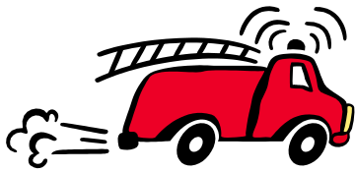
Introduction
A firewall, originally, is a wall that prevents spreading of fire through a building
More generally, it isolates things in case of hazard
Specifically, we will discuss isolating the Internet from a company network

Slide 4
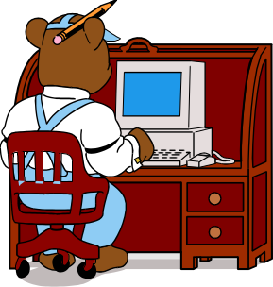
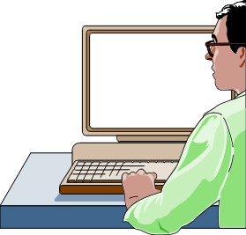

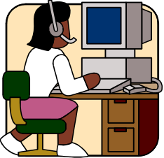
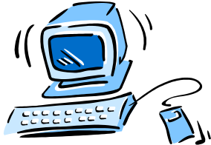
A firewall
Internet
Firewall
LAN

Slide 5
Principles of information security
What do you want to protect?
  Your data
    secrecy
    reliability
    availability
  Your hardware
  Your reputation

Slide 6
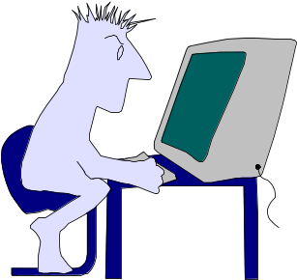
What do you want your firewall to do?
Increase security
Simplify maintenance of network
Save money
Be user friendly and non-disruptive
Notes:
It’s all the same thing!

Slide 7
What can your firewall do
A firewall protects your company LAN against
  known threats
  coming from outside
  via the firewall
  at connection level
  by making things harder to use.

Slide 8
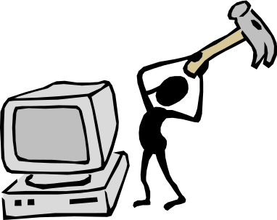
What can’t your firewall do
  Solve your security problem
  Protect against viruses
  Protect data that doesn’t flow through it
  Be “user friendly”
  Protect against every threat
  Protect against attacks from the inside

Slide 9
Examples
A firewall does not protect against viruses
    There’s a new example every month
A firewall does not protect against unknown attacks
    Firewall-1 DOS attack: July 2000
A firewall makes life harder
    If you had no front door lock, you wouldn’t have to stay home for the heating repairman. Wouldn’t that be convenient?

Slide 10

Maintaining a firewall
Most attacks are published in enough detail that people can figure out for themselves how to attack your machines.
  Install your system properly
  Read the news on known holes (e.g. SANS), and download the patches
    Watch out for fake patches
    Watch out for reliability of your machines
  Read your log files

Slide 11
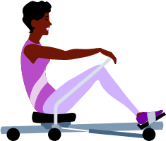
A firewall is not a machine
A firewall does not only consist of the firewall host machine, but also of:
  A security model
  A list of firewall settings (e.g., allowed services)
  Procedures to maintain the firewall host machine
  An operator or group of operators
  A list of guidelines

Slide 12
Basic rules
A few trivial but important rules for security maintenance:
  Use multiple layers of protection
  Keep it simple
  “No, unless” instead of “Yes, if”
  Monitor your systems
    Not only the firewall, but also the network behind it
  Decide on your security model
    Risk analysis is a very useful tool
Notes:
Example: an elevator
Multiple layers: not only cables, but also a braking clamp, a detector to see if there’s an elevator behind the door, a spring at the bottom of the shaft, and so on.
Keep it simple: the braking clamp is a simple mechanical device without any advanced control
No, unless: if anything is wrong, the elevator won’t go
Monitoring: even by the passengers
Security model: not protected against bombs, but protected against cable breakage

Slide 13

Layers of protection
A
B
A
B
C
C

Slide 14
Protocol stack
User Layer
Word, PDF
Application Layer
SMTP, FTP, Telnet
Transport Layer
TCP, UDP, ICMP
Internet Layer
IP
Network Access Layer
Ethernet, ATM
Notes:
Every communication happens on all there layers simultaneously; it is a matter of interpretation.

Slide 15
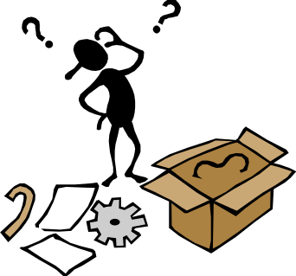
Example: firewall settings
  Allow useful low risk services: SMTP, POP (mail) , NNTP (news), HTTP (surfing)
  If you really need it, allow services like DNS (naming), IRC (chat), MBONE (video conferencing and the like)
  Don’t allow games, NTP(time), RIP, OSPF (routing), SNMP (management), NIS, WINS (naming)

Slide 16
Train your users
Users must know basic things in order to make effective use of security measures:
  The Internet is unreliable.
  Security through obscurity doesn’t work (they won’t notice I have all my passwords in a file called “secret”).
  Social engineering is hard to recognise.
I recommend to write a guidelines document for Internet usage.
Notes:
Security through obscurity is fine if you hide the cookies behind the beans in the kitchen closet to make sure your kids don’t eat them. This is a low risk application.
Hiding the door key under the mat is not so clever.
Social engineering: summer time in America is on the first Sunday in April, which was April 1st this year.

Slide 17
Guidelines for users
Things to consider putting in a guidelines document:
  Use the connections that are available
    No own phone connections, for example
  No downloading of objectionable material
    Filters annoy “good” users, and don’t stop “bad” users
  Don’t trust the outside world
    Social engineering is a serious threat
  Digital data is often more valuable than physical objects
Notes:
Don’t give the outside world hints they don’t need (like the version of your software)

Slide 18

Useful literature
There are a zillion books about information security out there. The ones I read recently and liked:
Elizabeth D. Zwicky, Simon Cooper and D. Brent Chapman: “Building Internet Firewalls”, second edition, O’Reilly
Bruce Schneier: “Secrets and Lies”

Slide 19
Conclusion
Basic rules of using any security system:
  Don’t trust anything
    Don’t put all your eggs in one basket
    Attacks may come from everywhere
  Know what you want to protect
    Use the simplest protection that protects it
  Train your users
  Stay alert

Slide 20
How to make a firewall useless
Trust your users
Use the default installation
Use a sophisticated self designed system that locks out everything dangerous
Assume the firewall will protect you forever

